Slide 1


Bottom-Up Intelligence Analysis (Part 1)
John Beverley
Assistant Professor, University at Buffalo
Co-Director, National Center for Ontological Research
Affiliate Faculty, Institute of Artificial Intelligence and Data Science

Slide 2
Outline
Model of Cognition
Intelligence Analysis on the Ground
Cognitive Bias in Intelligence Analysis

Slide 3
Outline
Model of Cognition
Intelligence Analysis on the Ground
Cognitive Bias in Intelligence Analysis

Slide 4
Model of Human Cognition
Human cognition is complicated, but can roughly be divided into four broad interrelated elements:
Individual at a Time
Individual over Time
Group at a Time
Group over Time
We will focus on the first today

Slide 5

Attention
We’re surrounded by a booming, buzzing, manifold of stimuli in our perceptual systems; too much stimuli to recognize at any given time
We restrict our attention to some parts of this perceptual manifold, whether it be visual, auditory, olfactory, etc. at any given time

Slide 6

Perceptual Encoding
We restrict attention, often ignore parts of our perceptual manifold
Suppose I’m looking for cufflinks before leaving for a show, but I can’t find them in my drawer
Later, on the way to the show, I realize that in fact I did see them in the corner of the drawer, but I didn’t recognize that I saw them…

Slide 7
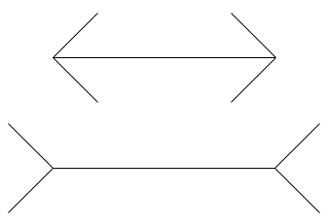
Perceptual Encoding
We’re encoding information even when not paying attention
Encoded information influences beliefs and desires, often without your awareness; some encodings are more inflexible than others...

Slide 8
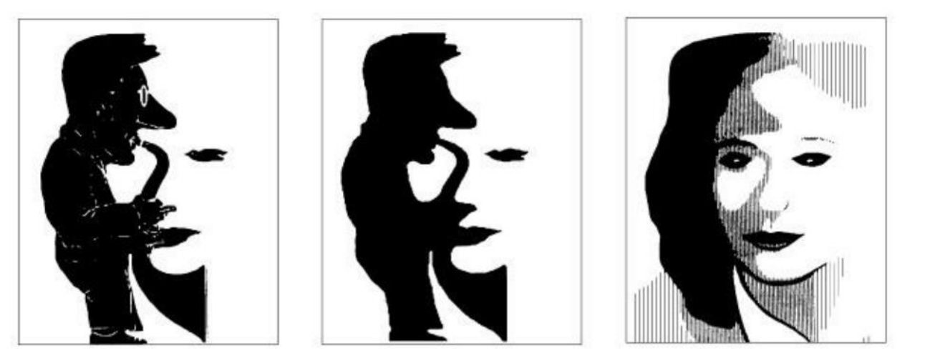
Perceptual Encoding
We’re encoding information even when not paying attention
Encoded information influences beliefs and desires, often without your awareness; some encodings are more flexible than others...

Slide 9


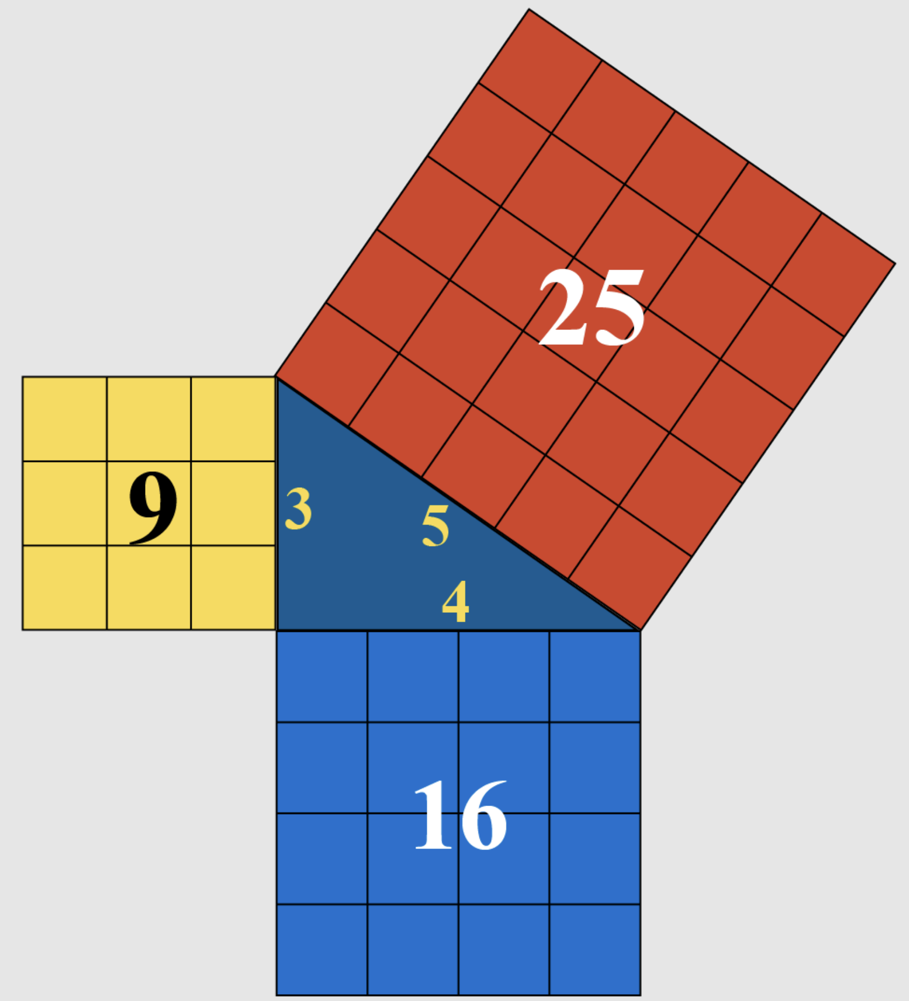
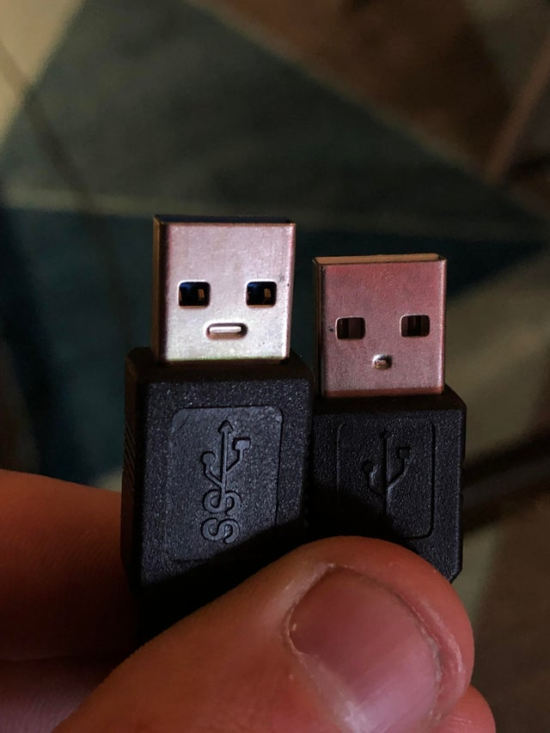

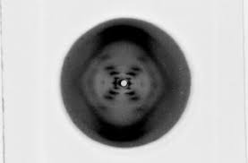
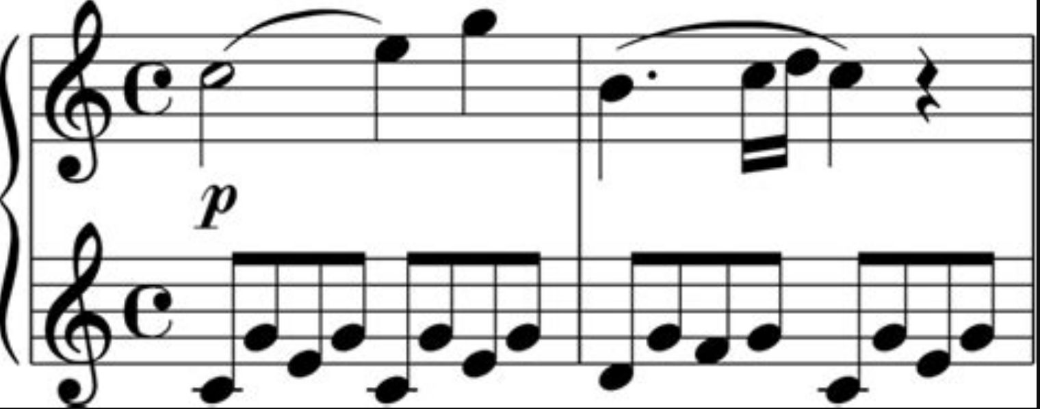
Pattern Recognition
We’re disposed to recognize patterns with our perceptual faculties…

Slide 10
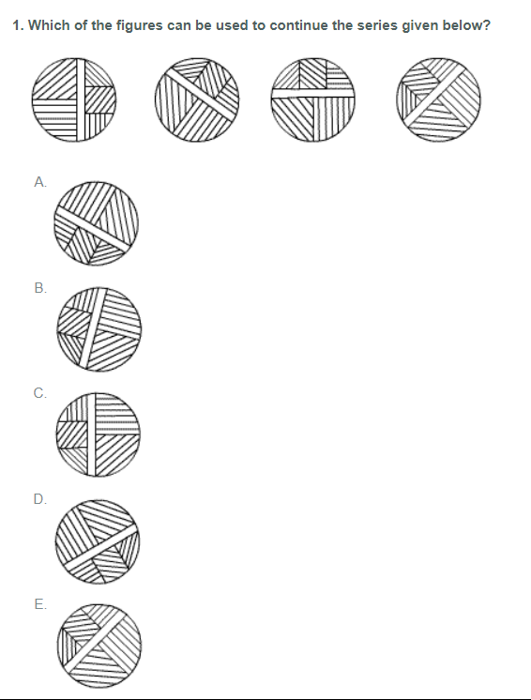
Raven Matrix

Slide 11
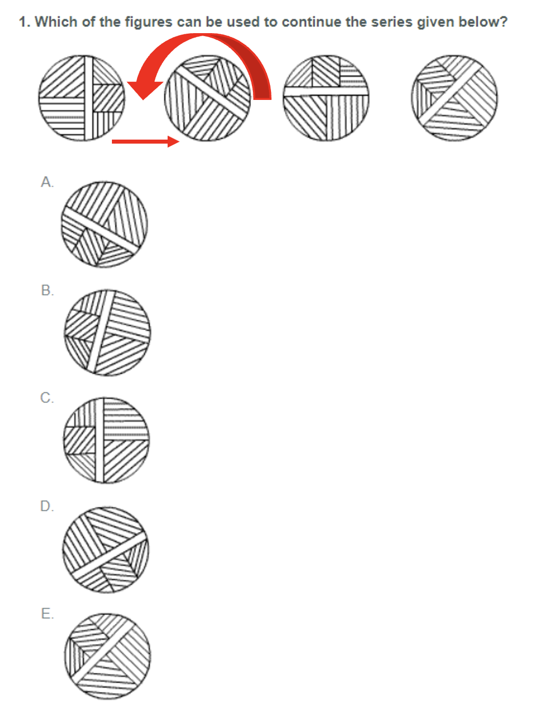
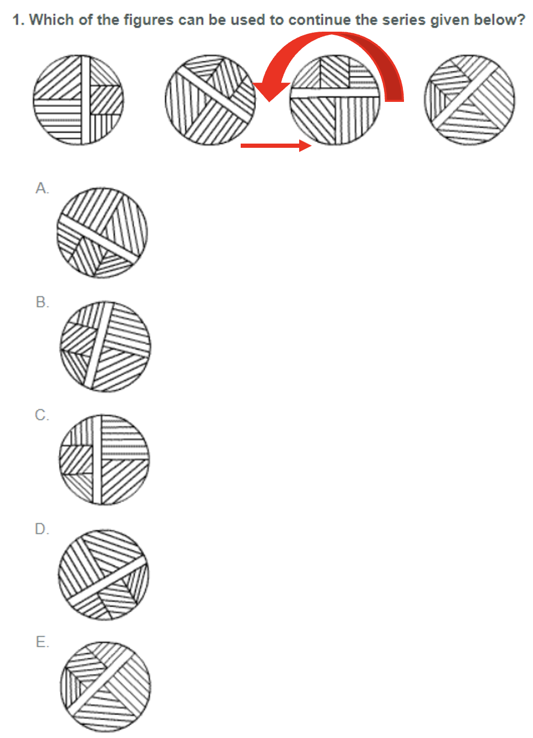
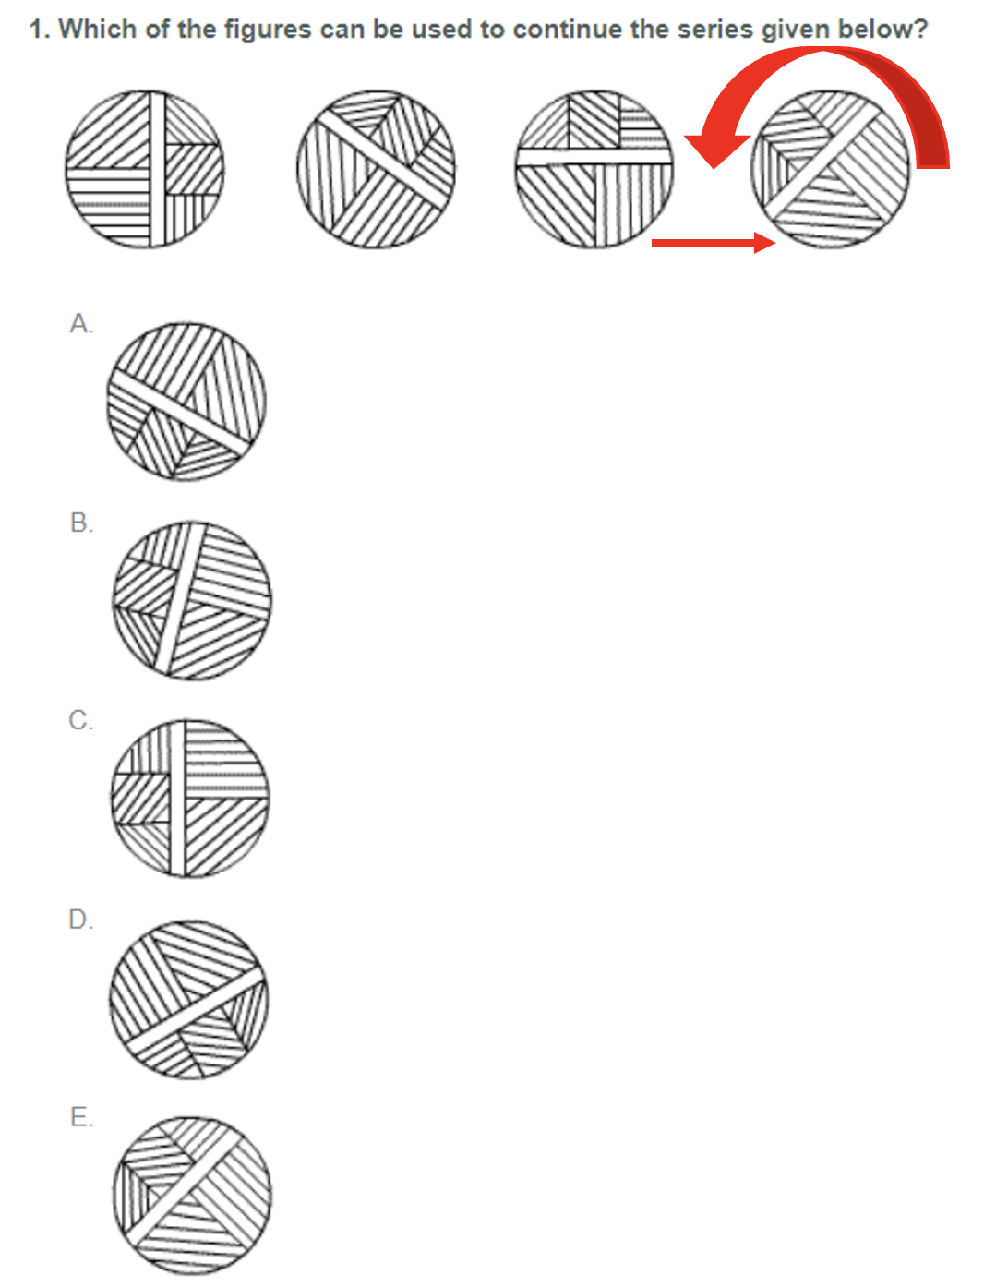
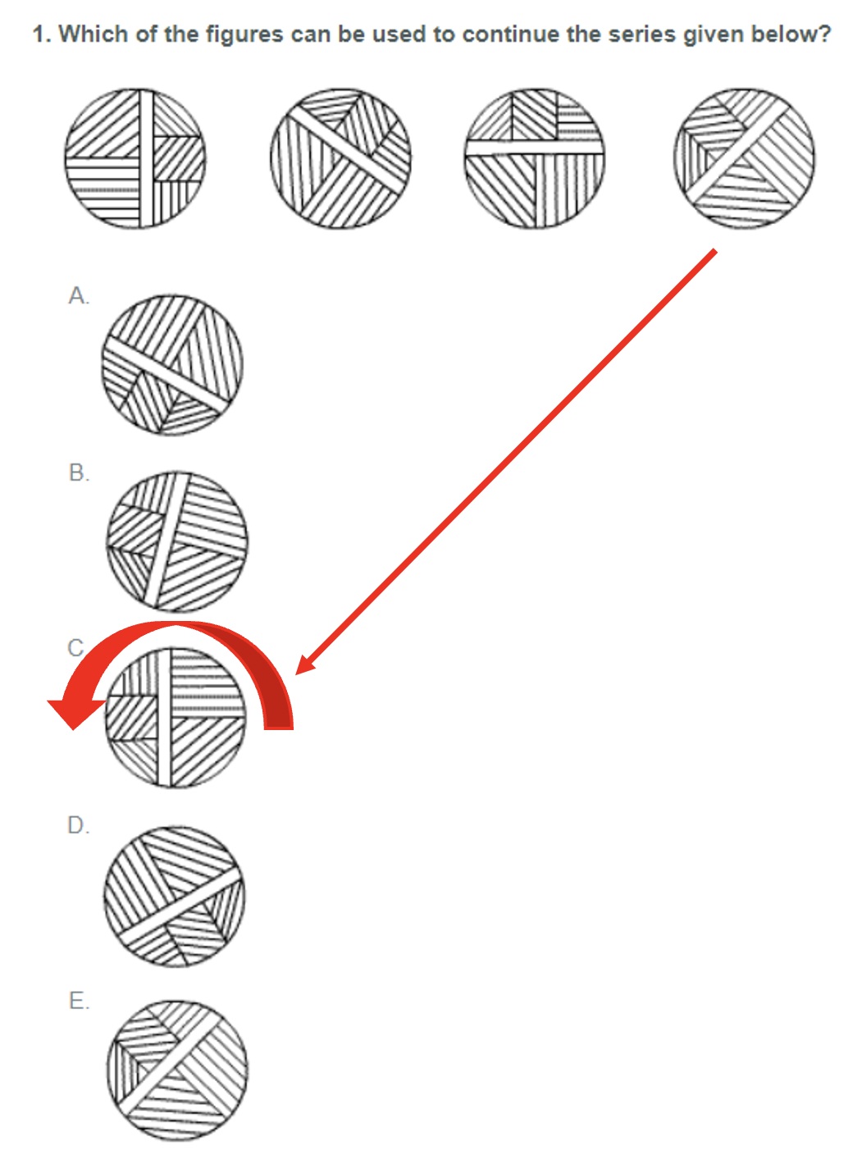
Raven Matrix

Slide 12
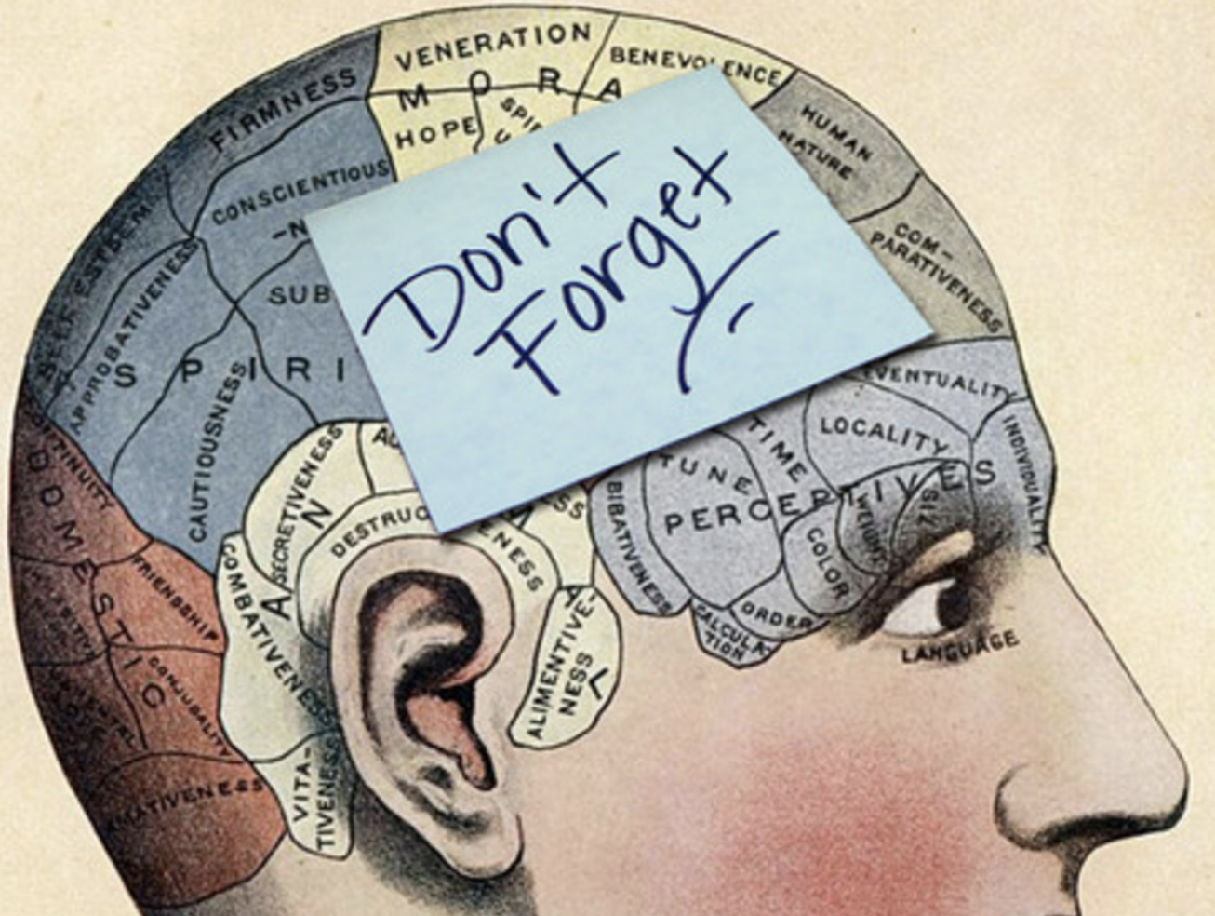
Memory
Added to this, we also have limited:
Working memory
Short term memory
Long-term memory
Rather than attempt to memorize everything we attend to in our perceptual field, we name things and refer to them later

Slide 13
Syntax vs Semantics
The word “dog” means something like ‘mammal that barks and is adorable and has a tail, etc…’
Semantics is the study of the meanings of terms
The word “dog” is a concatenation of symbols “d” “o” and “g”
Syntax is the study of the shape of terms

Slide 14



Syntax vs Semantics
We use language often to pick out things in the environment, e.g. naming
The shape of the letters differs from the meaning of the term, which differs from the object referenced by the term
“Dog”

Slide 15
Syntax vs Semantics
We use language often to pick out things in the environment, e.g. naming
“Dog”
Name

Slide 16
Syntax vs Semantics
We use language often to pick out things in the environment, e.g. naming
“Dog”
Name
Thing Named

Slide 17
Syntax vs Semantics
You can see this by observing the difference between use of a term and mention of a term
“Dog” has 3 letters
But a dog doesn’t have any letters

Slide 18
Syntax vs Semantics
You can see this by observing the difference between use of a term and mention of a term
“Dog” has 3 letters
But a dog doesn’t have any letters
Use

Slide 19
Syntax vs Semantics
You can see this by observing the difference between use of a term and mention of a term
“Dog” has 3 letters
But a dog doesn’t have any letters
Mention
Use

Slide 20
Group Exercise
You can surprisingly extract meaning from the shapes of terms even when you don’t know their meanings
Follow the link below to play The Gostak
http://iplayif.com/?story=http%3A%2F%2Fwww.ifarchive.org%2Fif-archive%2Fgames%2Fzcode%2Fgostak.z5
Your task is to distunk the five glauds…

Slide 21
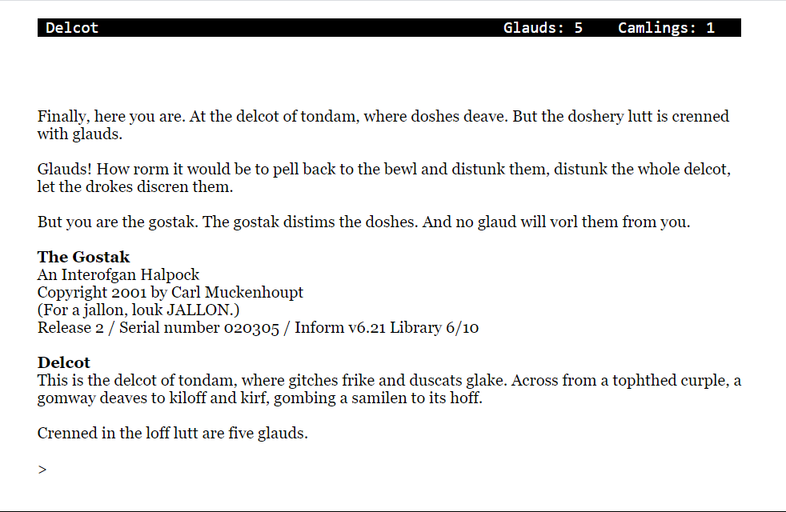

Slide 22
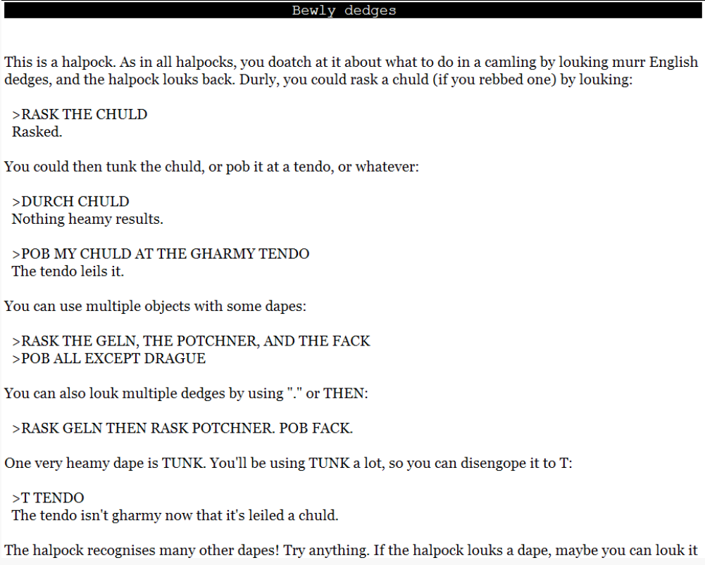
Here’s a screenshot of the help file…

Slide 23
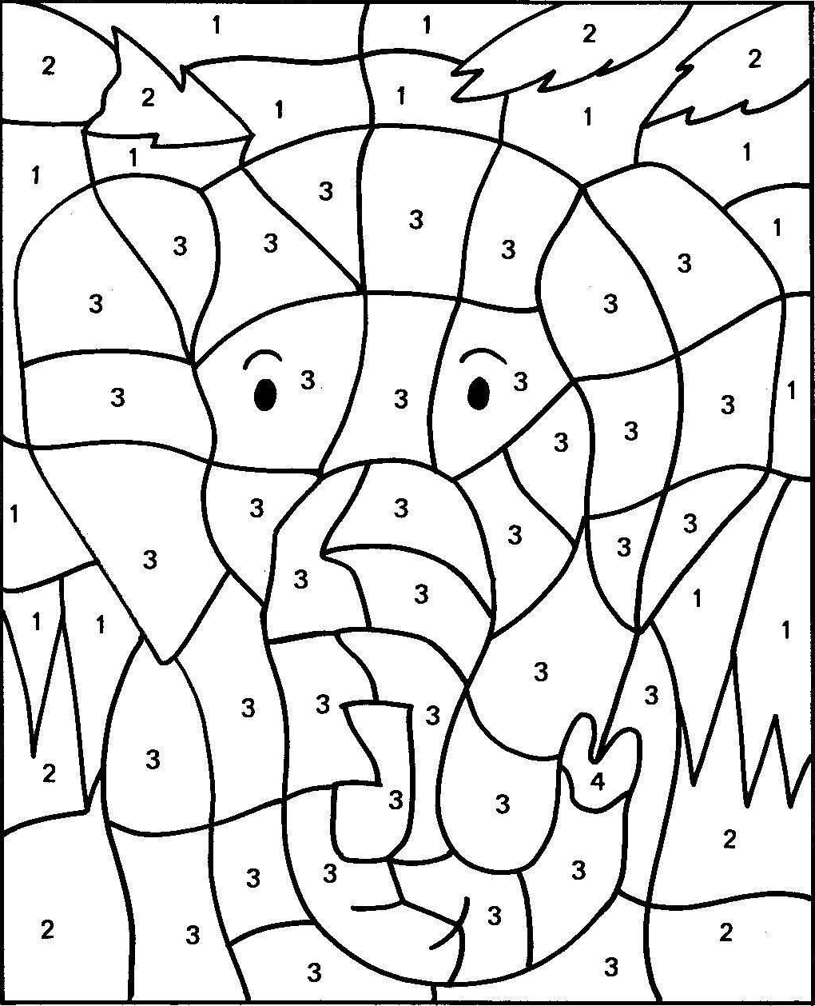
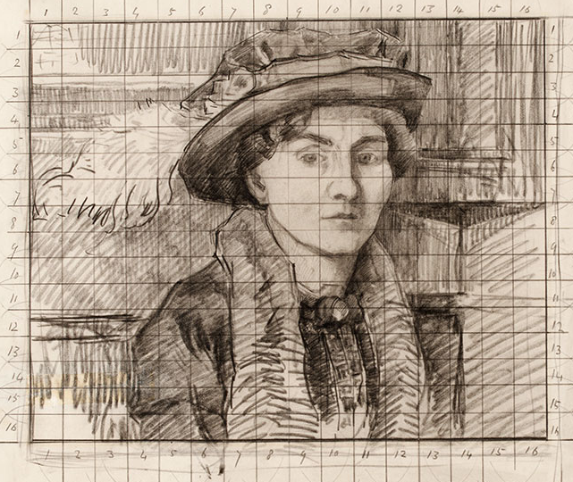
Divide & Conquer
Naming is a divide-and-conquer heuristic that is useful for entities with limited memory like us; it allows us to break down complex information into digestible parts
Paint
by Numbers
Grid
Method

